Slide 1
Post Covid-19 New Yorker Travel guidance
Charlies shin, ChangHsinyi, LJ Zhang, Mubai, Wen Yin

Slide 2
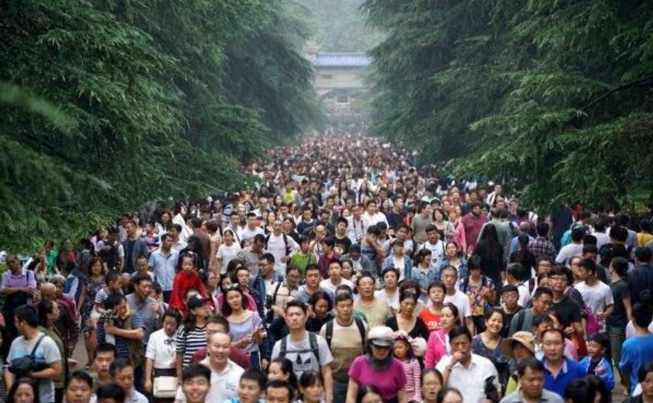
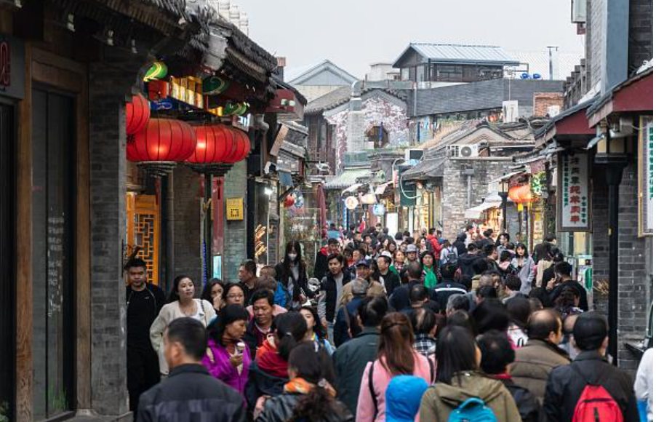
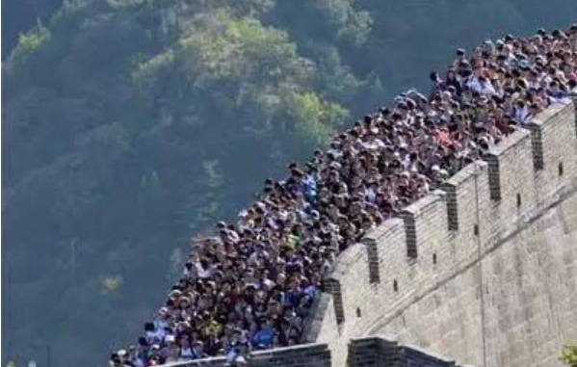
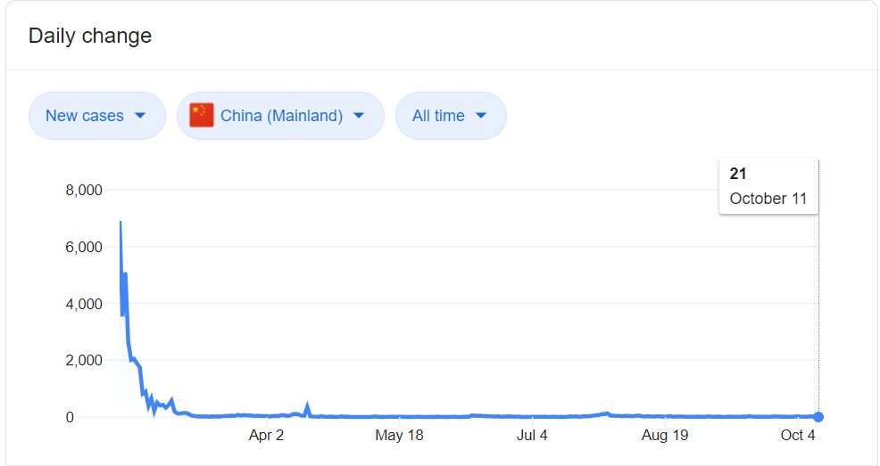
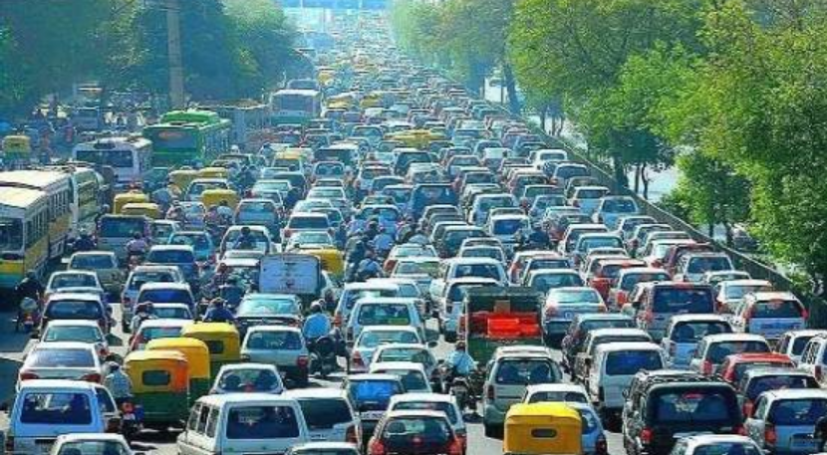
Chinese tourist sites packed during “Golden Week” holiday as country comes out of lockdown
Data shows that the busy holiday vacation did generate $ 66.64 billion tourism revenues without bringing a “second wind” of COVID-19 infection (JHU CSSE)

Slide 3
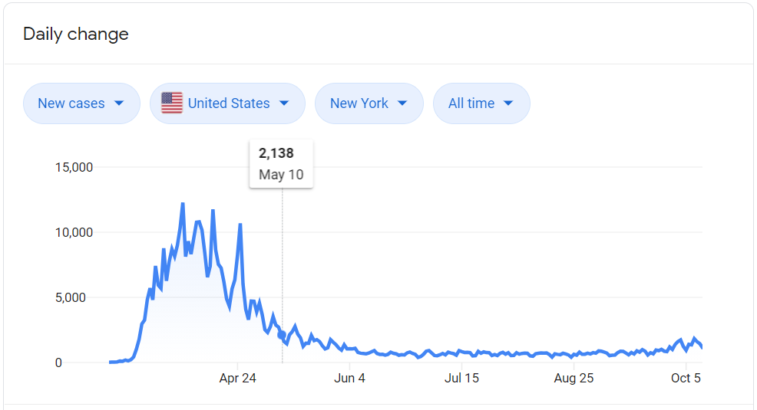
Today’s China will be Tomorrow’s America I mean, for the COVID-19 part
After three months of flat new confirmed cases, New York City has entered Phase 4 of reopening, which includes Higher Education, Pre-K to Grade 12 Schools, Gyms and Fitness, Indoor dinning of restaurants.
After half a year quarantine, where could New Yorkers go to enjoy their winter holiday?

Slide 4
Someone may jump out to argue….
Wait, even the curve for new confirmed cases are flat and low for three months, there are still not “absolute zero”
34,000 US citizen died because of Flu in 2019, and 61,000 died in 2018 for the same reason (CDC). However, Flu is there for decades and American keeps traveling.
A meaningful and enjoyable life suppose to be somehow “risky”

Slide 5
Someone may Keep arguing….
What if I stay at home, work and study remotely, call for food delivery everyday. No drink, No sport, No vacation, No hangout, No dating.
Could I have “absolute zero” risk ?

Slide 6

Risk Measurement
Sadly, that “risk free strategy” will actually bring him the risk to become a boring and single nerd, forever.
Our Mission today is to help New Yorker measure the risk of winter holiday vacation and try to figure out potential “high return, low risk” options.

